Slide 1
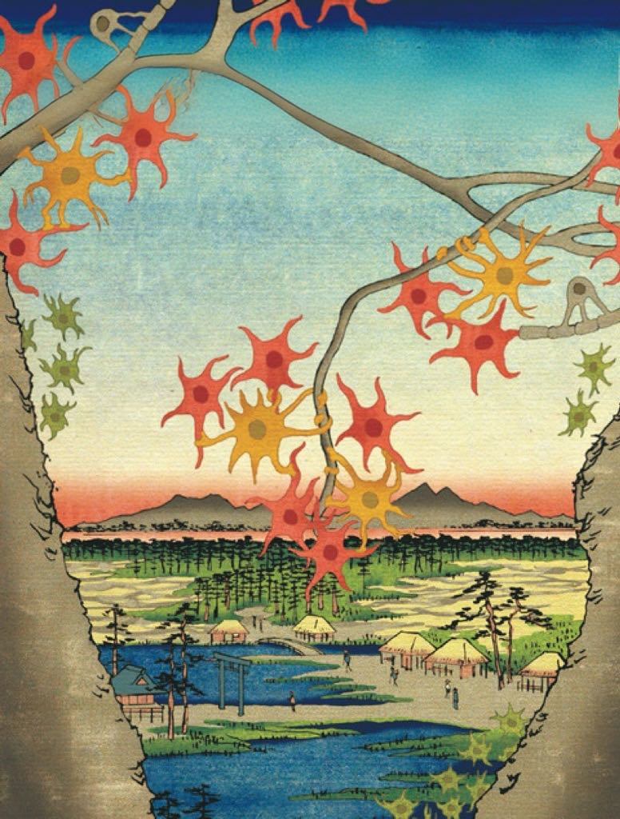
The Sheltering Metaphors
The Sheltering Metaphors
Electricity and the Making of Hodgkin-Huxley Model (1926-1963)
Yi Xiao

Slide 2

Contents
Contents
Research Questions & Framework &Conclusion
Interlocutors
Contribution & Limitations

Slide 3
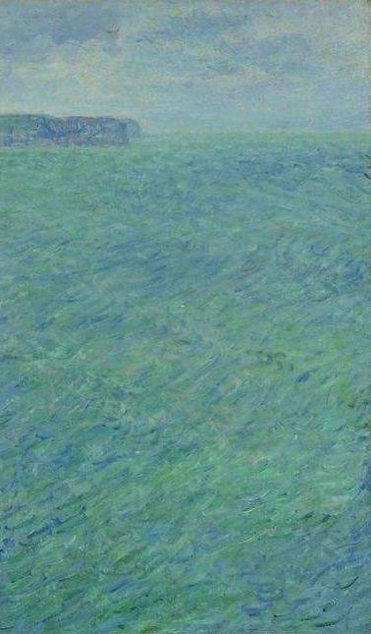
Timeline
Hodgkin and Huxley published five papers in a row that established the HH Model.
Adrian used Morse Code as the metaphor for neuron activity.
1939
1963
Hodgkin and Huxley first placed electrodes inside squid cells to record electrical signals.
Hodgkin and Huxley won Nobel Prize in Physiology or Medicine.
1926
1952

Slide 4
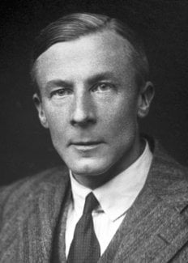
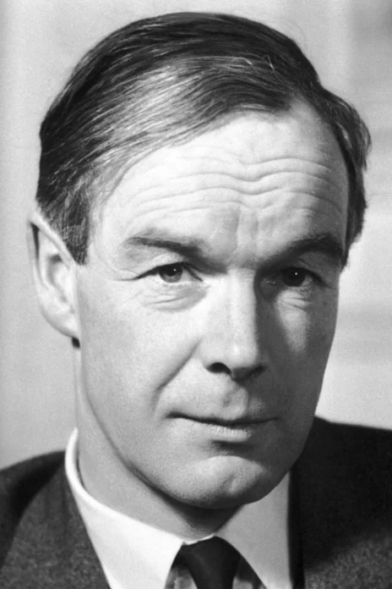
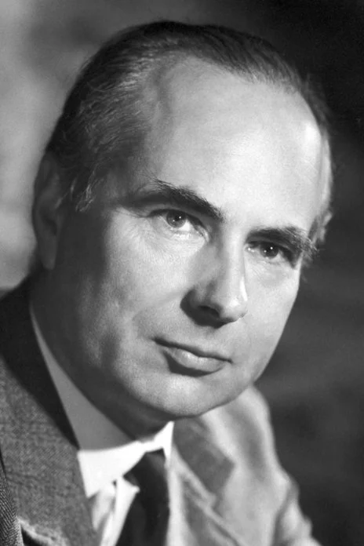
Metaphor Shifting
Research Questions
Photos from the Nobel Foundation archive.
Why did Hodgkin and Huxley adhere to the older theoretical model?
How has their research been reconciled with the rise of information theory and modern computational neuroscience?
Edgar Adrian
(1889-1977)
Alan Hodgkin
(1914-1998)
Andrew Huxley
(1917-2012)

Slide 5
Historical Sources
The historical sources used in this paper consist primarily of two parts：
1. publication: scientists’ essays, memoirs, autobiographies, eulogies; transcripts of lectures and interviews.
2. unpublished archives:
（1）Alan Hodgkin Papers organized by Trinity College, Cambridge
（2）Warren McCulloch Papers in the American Philosophical Society Digital Collection.

Slide 6




Framework
Framework
From Electrical Systems to Electronic Circuits: Neurophysiology and Its Mechanical Metaphors
“Mostly Membranes”：Radar, Math and Modeling
Beyond “Spark” and “Soup” ： Forgotten Theories and Amnesia in Science

Slide 7
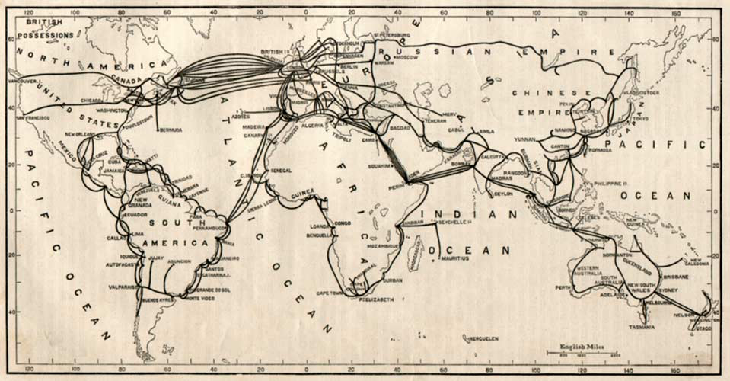
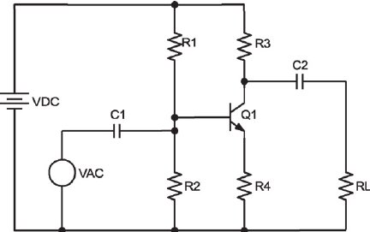
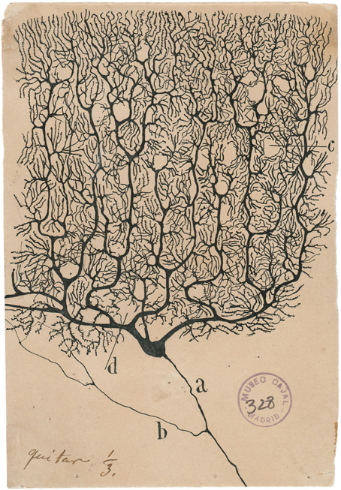
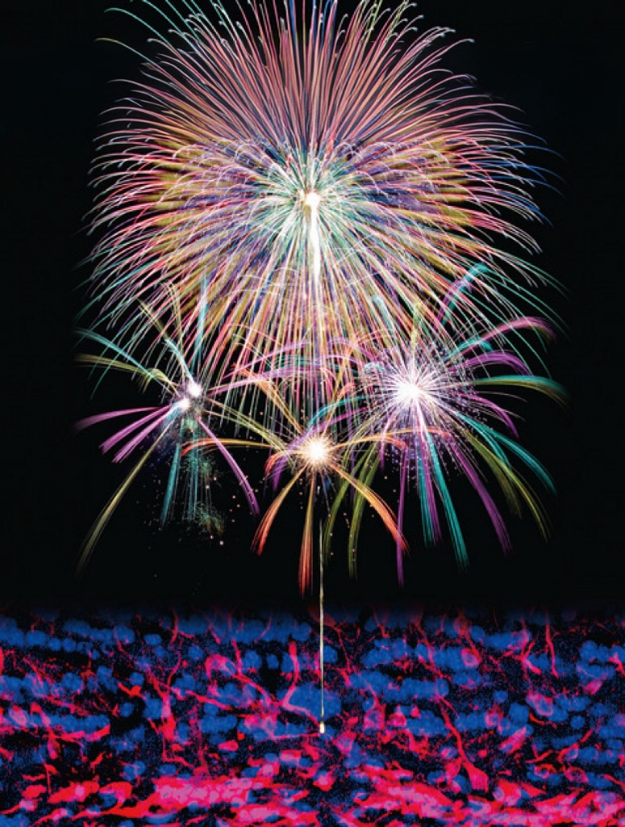
Metaphor Cluster
A metaphor is a tool we use to explore unknown territory and gain new knowledge by borrowing familiar concepts based on intuitive similarities in how things work or relate to each other.
People use all sorts of everyday things to compare neural activity.

Slide 8
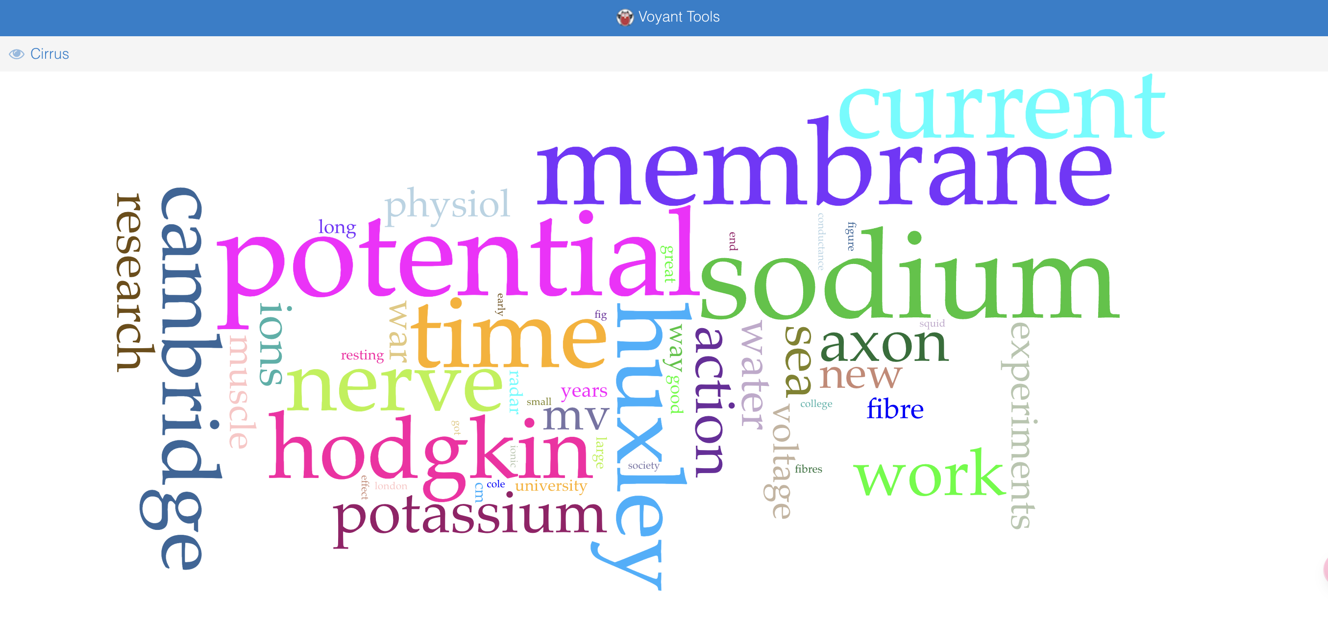
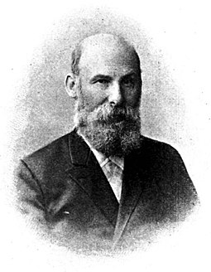

German physiologist Julius Bernstein
(1839–1917)

Slide 9
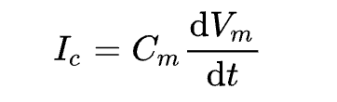
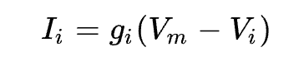
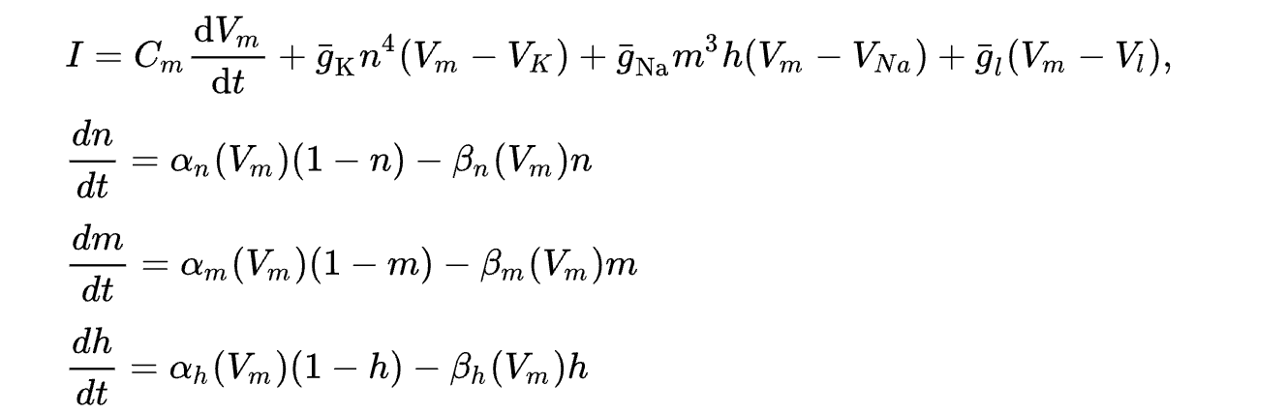
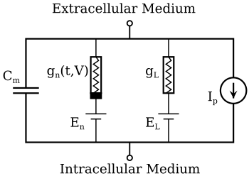
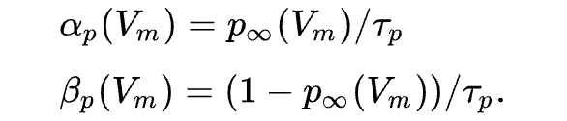
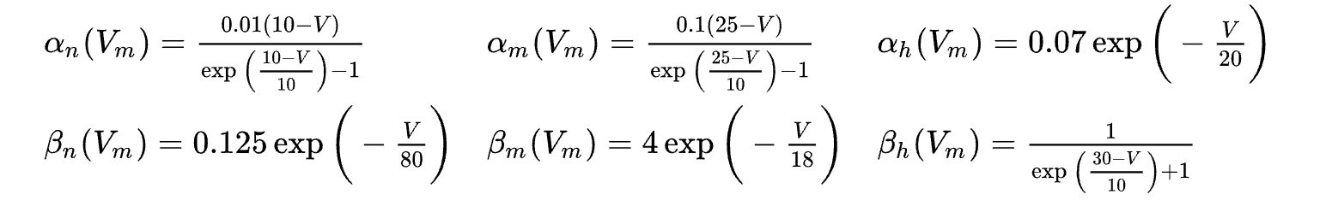
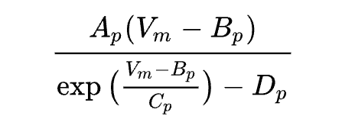
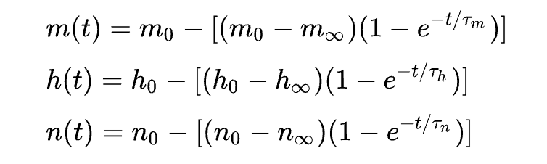
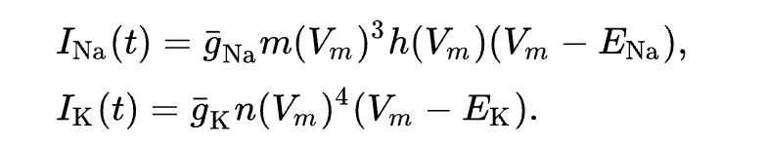
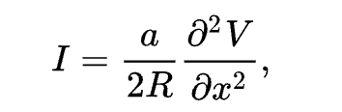
Mathematical Model
Mathematical formalization cannot be fully equated with informatization.

Slide 10
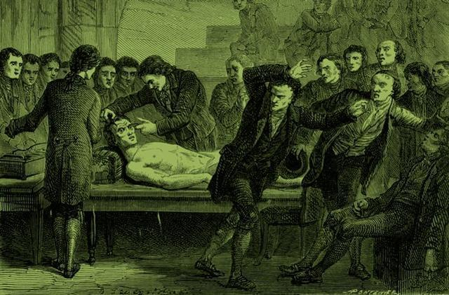

Dominant Metaphor：Electricity
Submarine Cable Map 1894
The Schematic Representation of a Simple Electronic Circuit
The Frankenstein Complex in Modern Neuroscience

Slide 11
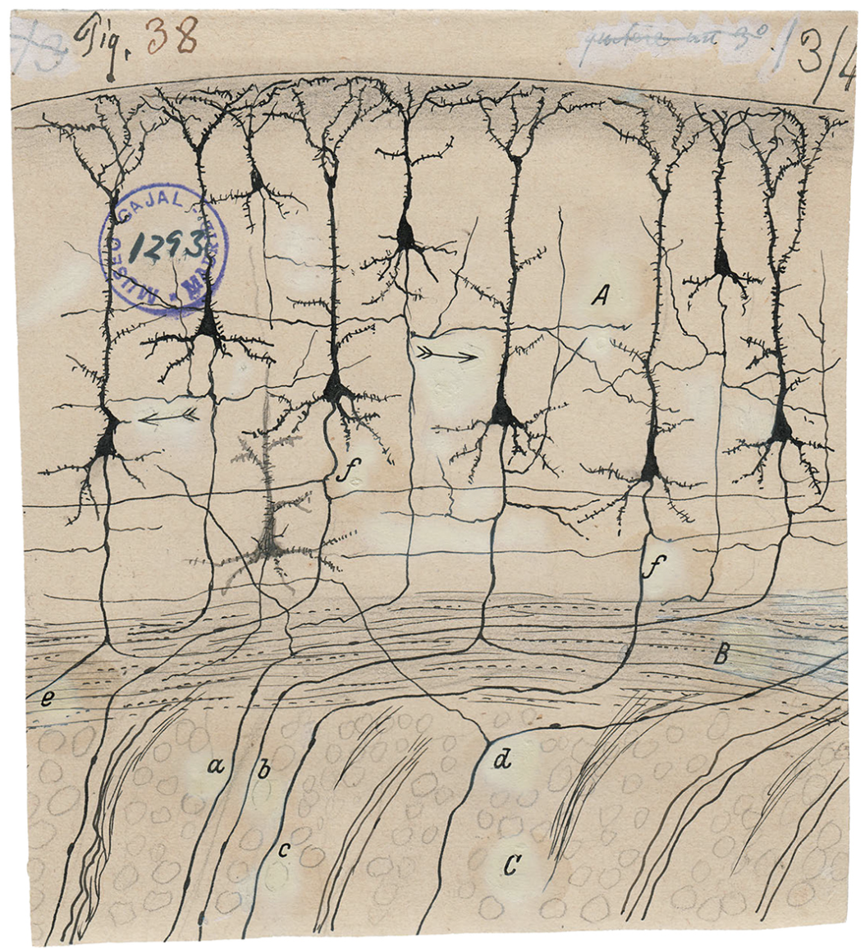
Obscured
The “garden metaphor” of Spanish neuroscientist Ramon y Cajal(1894), one of the key proponents of neuron theory. It emphasizes the organic properties of neurons, has received renewed attention with the “theory of neuroplasticity.
This is the cover of a Japanese science journal Genes to Cells(vol. 23, no.8, Aug. 2018), where the illustrator imagines neuron discharges as fireworks blooming.

Slide 12
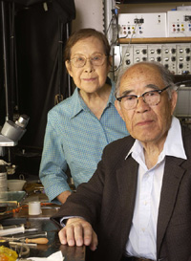
Brain Cells Communicate with Mechanical Pulses, Not Electric Signals？
Ichiji Tasaki
(October 10, 1910 – January 4, 2009)
a Japanese-born American biophysicist and physician involved in research relating to the electrical impulses in the nervous system.
A variety of other non-electrical manifestations that are shielded from neural activity: mechanical, thermal, and optical.

Slide 13
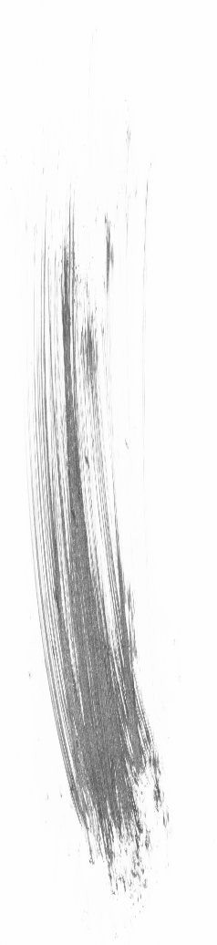
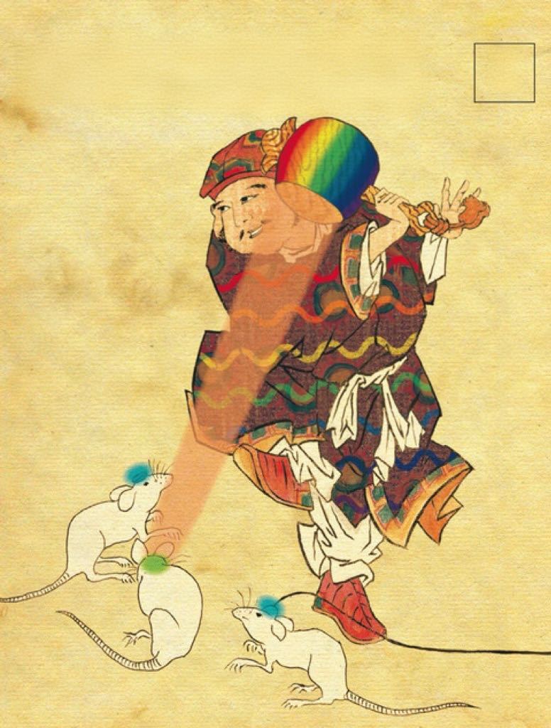
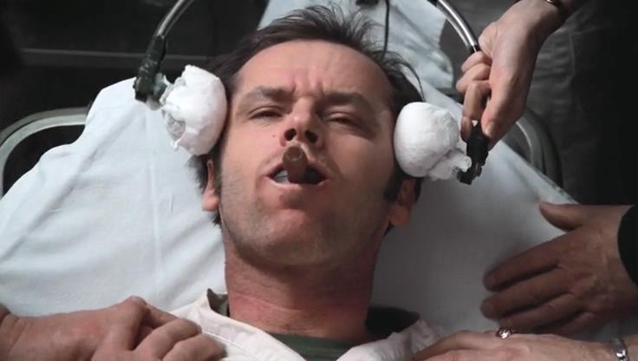


Counter-intuition
Take for example the mind manipulation technology that is most talked about in pop culture, since we all know that the nervous system releases electrical signals, then thinking intuitively, to manipulate the nerves you should electrify them.
But the technology for precise neural manipulation is currently achieved through light.

Slide 14
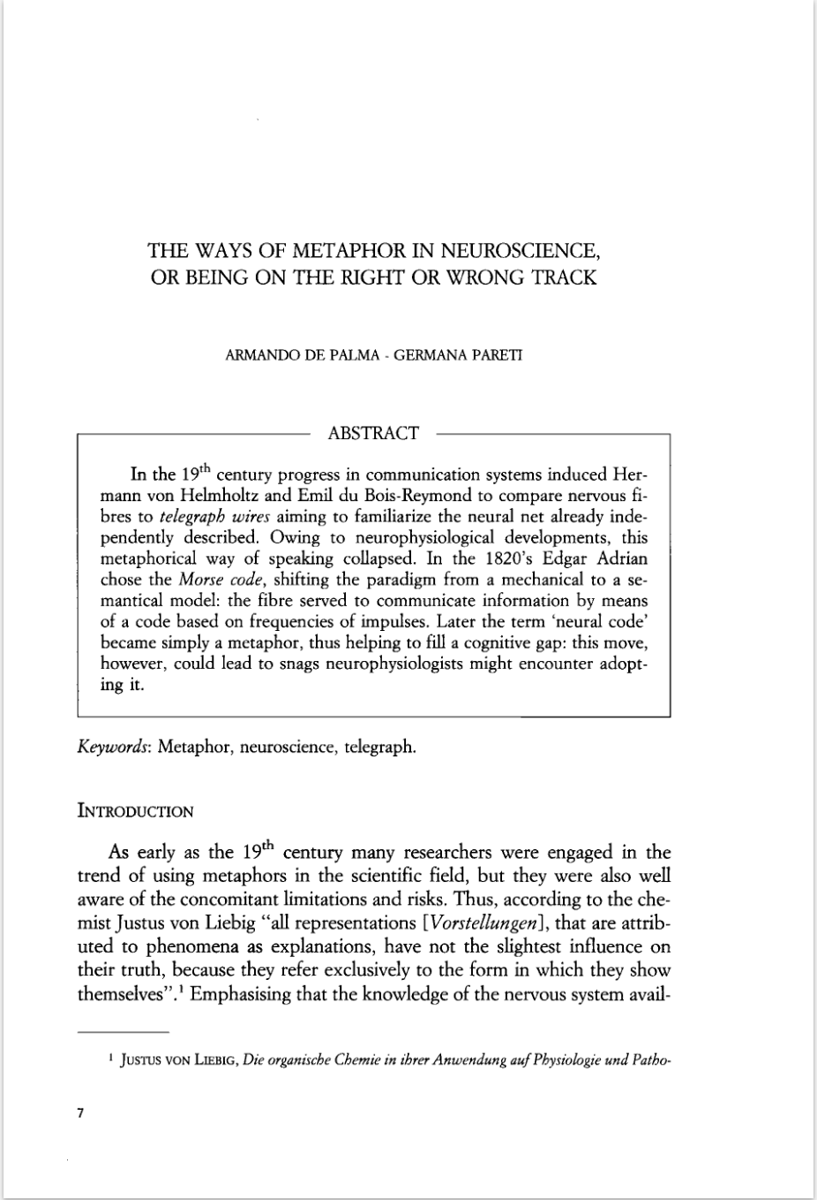
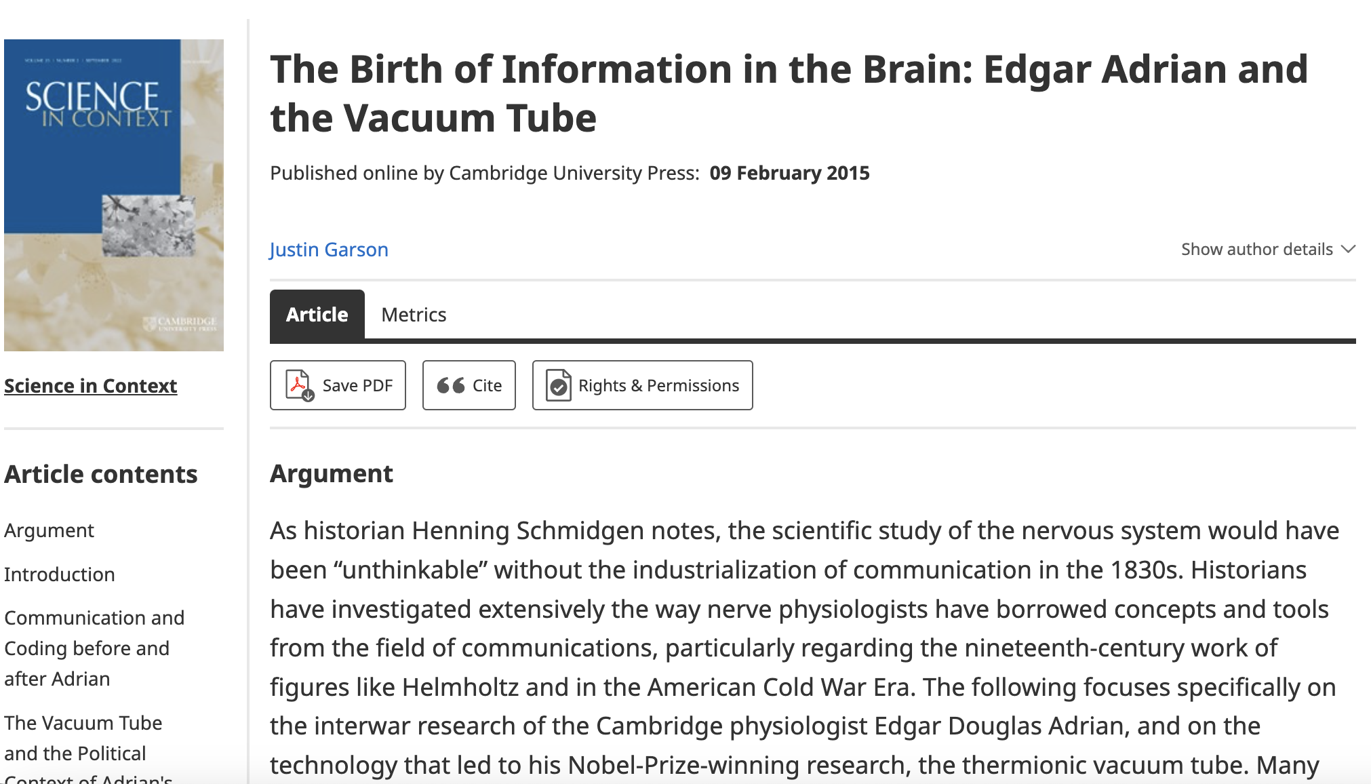
Dialogue Partner of this paper
Dialogue Partners of this paper

Slide 15
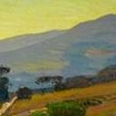
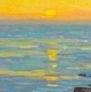
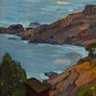
Contribution
Contribution
1
Using a cognitive science perspective to study metaphors in science.
2
Linking metaphors and models in neuroscience through the lens of function and thinking about how they work together to contribute to theory development.
3
Places the case study in the context of the history of the discipline of neuroscience in the first half of the 20th century, and endeavors to place them in the broader context of how World War II reshaped postwar science.

Slide 16
Limitation
Limitation
Significance of Historiography？
The metaphorical view of science is one which goes some way to bridging the gap between science and the arts.
-- W. H. Leatherdale
Insufficient use of archives.
“unapproachable” writing.

Slide 17

THANKS FOR LISTENING！
QUESTIONS？

